Slide 1



Exploring the use of mobile phone data for national migration statistics in Namibia
VIVIAN CHEN | SHAWN LIANG
Notes:
Shawn

Slide 2
First of all, where is Namibia?
Namibia
Notes:
Shawn

Slide 3


WHY IS MIGRATION IMPORTANT TO SOCIETY?
WHAT CAN YOU DO AFTER ESTIMATING THE STATISTICS FOR MIGRATION?
Notes:
Shawn

Slide 4


Human populations are highly mobile in the modern world. Migration determines changes in population size, distribution, and structure.
Statistics on internal migration are important for: urban planning, infrastructure development, and impact assessment, among other applications.
WHY IS MIGRATION IMPORTANT TO SOCIETY?
Migration brings different cultures together to create a more open-minded society and new opportunities.
It also impacts economy positively by contributing to GDP.
Notes:
Shawn

Slide 5
Study Motivation
What is the purpose of this research?
Why is this topic interesting?
Notes:
Shawn

Slide 6
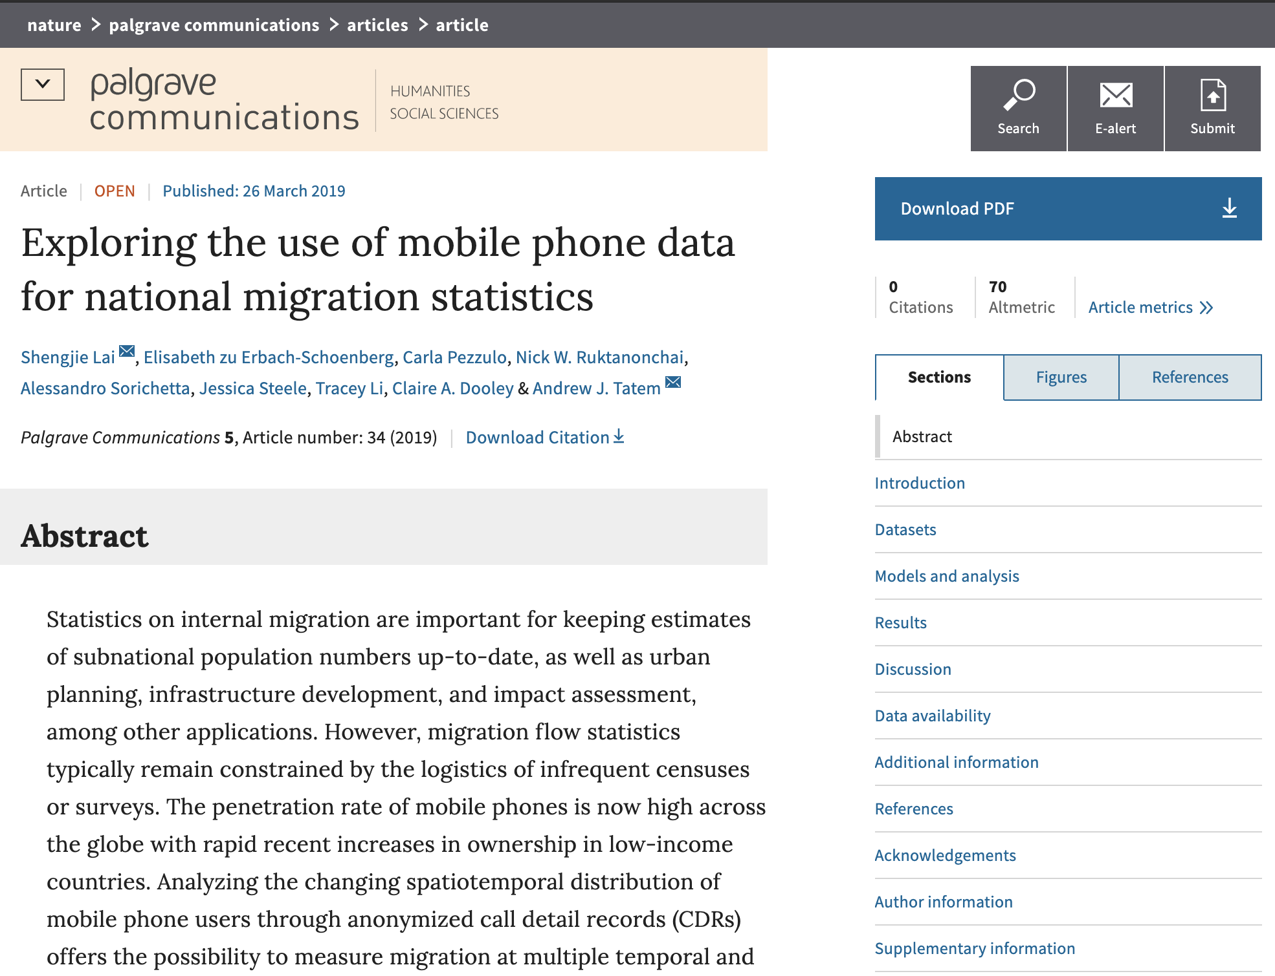


Accurate migration statistics
10 Year Census
Mobile devices are common nowadays
Cell Detail Records(CDRs)
Notes:
Shawn
After going thru different websites, and looking thru many research papers. We decided on this one
It was the only one we found that had a proper dataset and looked interesting enough for us.
We were talking to TA Felber and he told us that we should have found a database first, and then find a research paper accordingly.
We now learn that next time we should do that.
So, back on track, the purpose of this research paper is to explore the use of mobile phone data for national migration statistics
These researchers saw the importance of an accurate estimates for national population, and knew that the 10 year- census probably was not the best way to obtain the information
Many people have mobile devices nowadays, and the researchers thought of using the call detail records (CDRs) to track where the call activities had been and determined a migration/movement of a user.

Slide 7
STUDY MOTIVATION
Learn More about Migration
As migration impacts the demographic and socio-economic aspects of a country, it has become one of the most challenging issues confronting policymakers for nations around the world.
Development of jobs
Distribution of resources
New Way to Estimate Migration
Estimation can be derived and modeled from (call detail records) CDRs at subnational and annual scales, and how precision and accuracy of these estimates compare to census-derived migration statistics.
5 - 10 years census
Infrequent and expensive
More info about the research: https://www.nature.com/articles/s41599-019-0242-9
Notes:
As migration impacts the demographic and socio-economic aspects of a country, it has become one of the most challenging issues confronting policymakers for nations around the world
For instance, identifying where people migrate internally is often vital in development work, as migrants might be marginalized and at higher risk due to a lack of resources to meet demands
However, our knowledge of contemporary internal migration patterns remains poor for many countries (Garcia et al. 2015; Sorichetta et al. 2016; International Organization for Migration, 2017b), and is difficult to update between data collections for the majority of countries around the world.
Data collected from traditional sources, such as national population and housing censuses and household surveys, are the primary source for migration statistics (International Organization for Migration, 2018). Within population and housing censuses, migration is typically measured through a change in residence over a 1-year or 5-year period prior to the census. The increasing use of global positioning systems (GPS) has supported the collection of more spatially precise data, but each census only provides a single snapshot of migration flows, commonly once every decade, and migration patterns typically change over time between censuses or surveys (Namibia Statistics Agency, 2013; Wesolowski et al. 2013). Moreover, surveys only sample a small proportion of population, and the logistical challenge of censuses makes them an infrequent and expensive source of demographic data (Wardrop et al. 2018).

Slide 8
Main Results
What have the researchers found?

Slide 9


Main Results
Gravity-type spatial interaction models built using CDRs can accurately capture migration flows.
Estimates of migration flows made using mobile phone data is a promising avenue for complementing more traditional national migration statistics and obtaining more timely and local data.
Notes:
Shawn

Slide 10
Main Movements
Highest Migration Into
Khomas, the capital region of Namibia
Khomas is one of the fourteen regions of Namibia. Its name refers to the Khomas Highland, a high plateau landscape that dominates this administrative unit. Khomas Is centered on the capital city Windhoek and provides for this reason superior transportation infrastructure.
Highest Migration Out
Zambezi, region in the northeast of Namibia
Zambezi is the fourth-longest river in Africa, the longest east-flowing river in Africa and the largest flowing into the Indian Ocean from Africa.
According to the 2011 Namibia population and housing census (Namibia Statistics Agency, 2015), a total of 40,867 Namibian (2.0% of 2,013,671 people) migrated by changing their places of residence between regions in Namibia over the one-year period prior to the census in August 2011,
Notes:
for a better life and better opportunities. Everybody has their own special or specific place they like. Windhoek is a beautiful city and its one of the most developed cities in Africa. Its big and amazing. All the facilities are available. Not to talk of the big shopping malls and the lovely weather, all though is really dry here but it rains and the winter. Its a perfect place to stay in. The real town ship and school are even easier to find. I hope I have been able to convince you, feel free to stay where you are more comfortable

Slide 11
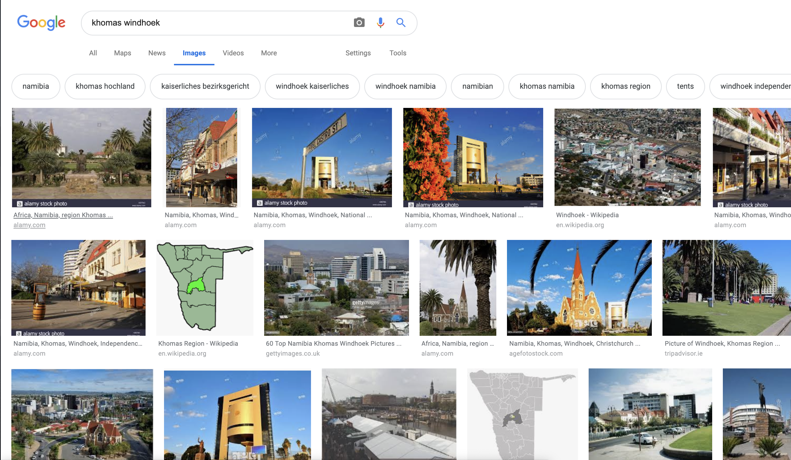
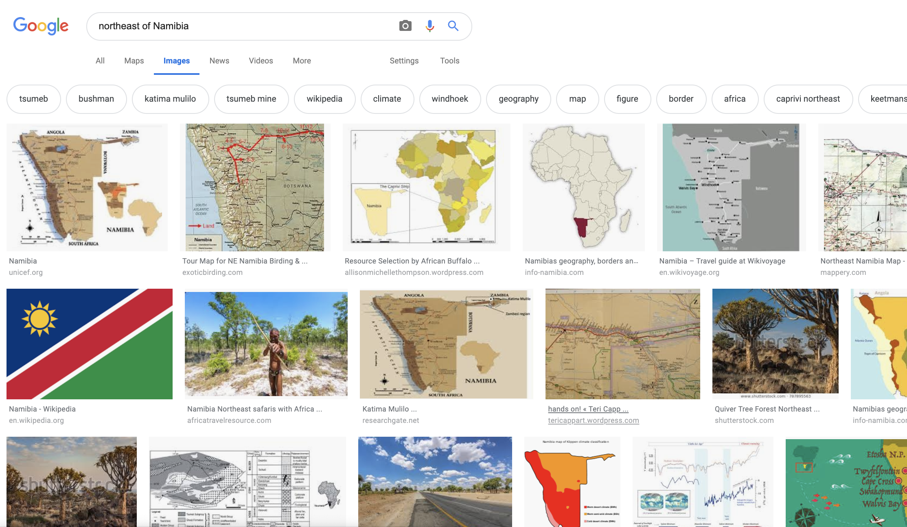
What they look like
Notes:
for a better life and better opportunities. Everybody has their own special or specific place they like. Windhoek is a beautiful city and its one of the most developed cities in Africa. Its big and amazing. All the facilities are available. Not to talk of the big shopping malls and the lovely weather, all though is really dry here but it rains and the winter. Its a perfect place to stay in. The real town ship and school are even easier to find. I hope I have been able to convince you, feel free to stay where you are more comfortable

Slide 12
Data Visualization
The following images are made from Circos and Mathematica

Slide 13
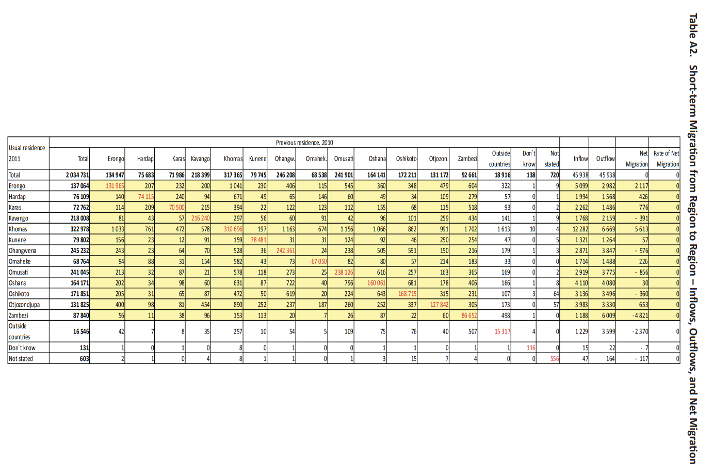
[2]

Slide 14
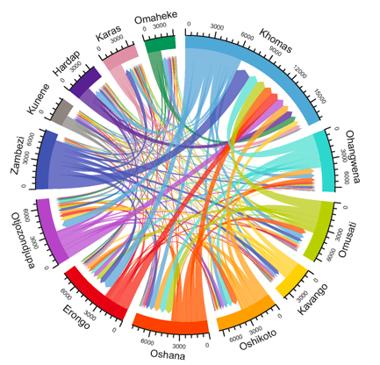
Figure from Article [1]
Figure 1.
Short-term Migration from Region to Region in Namibia in 2011

Slide 15
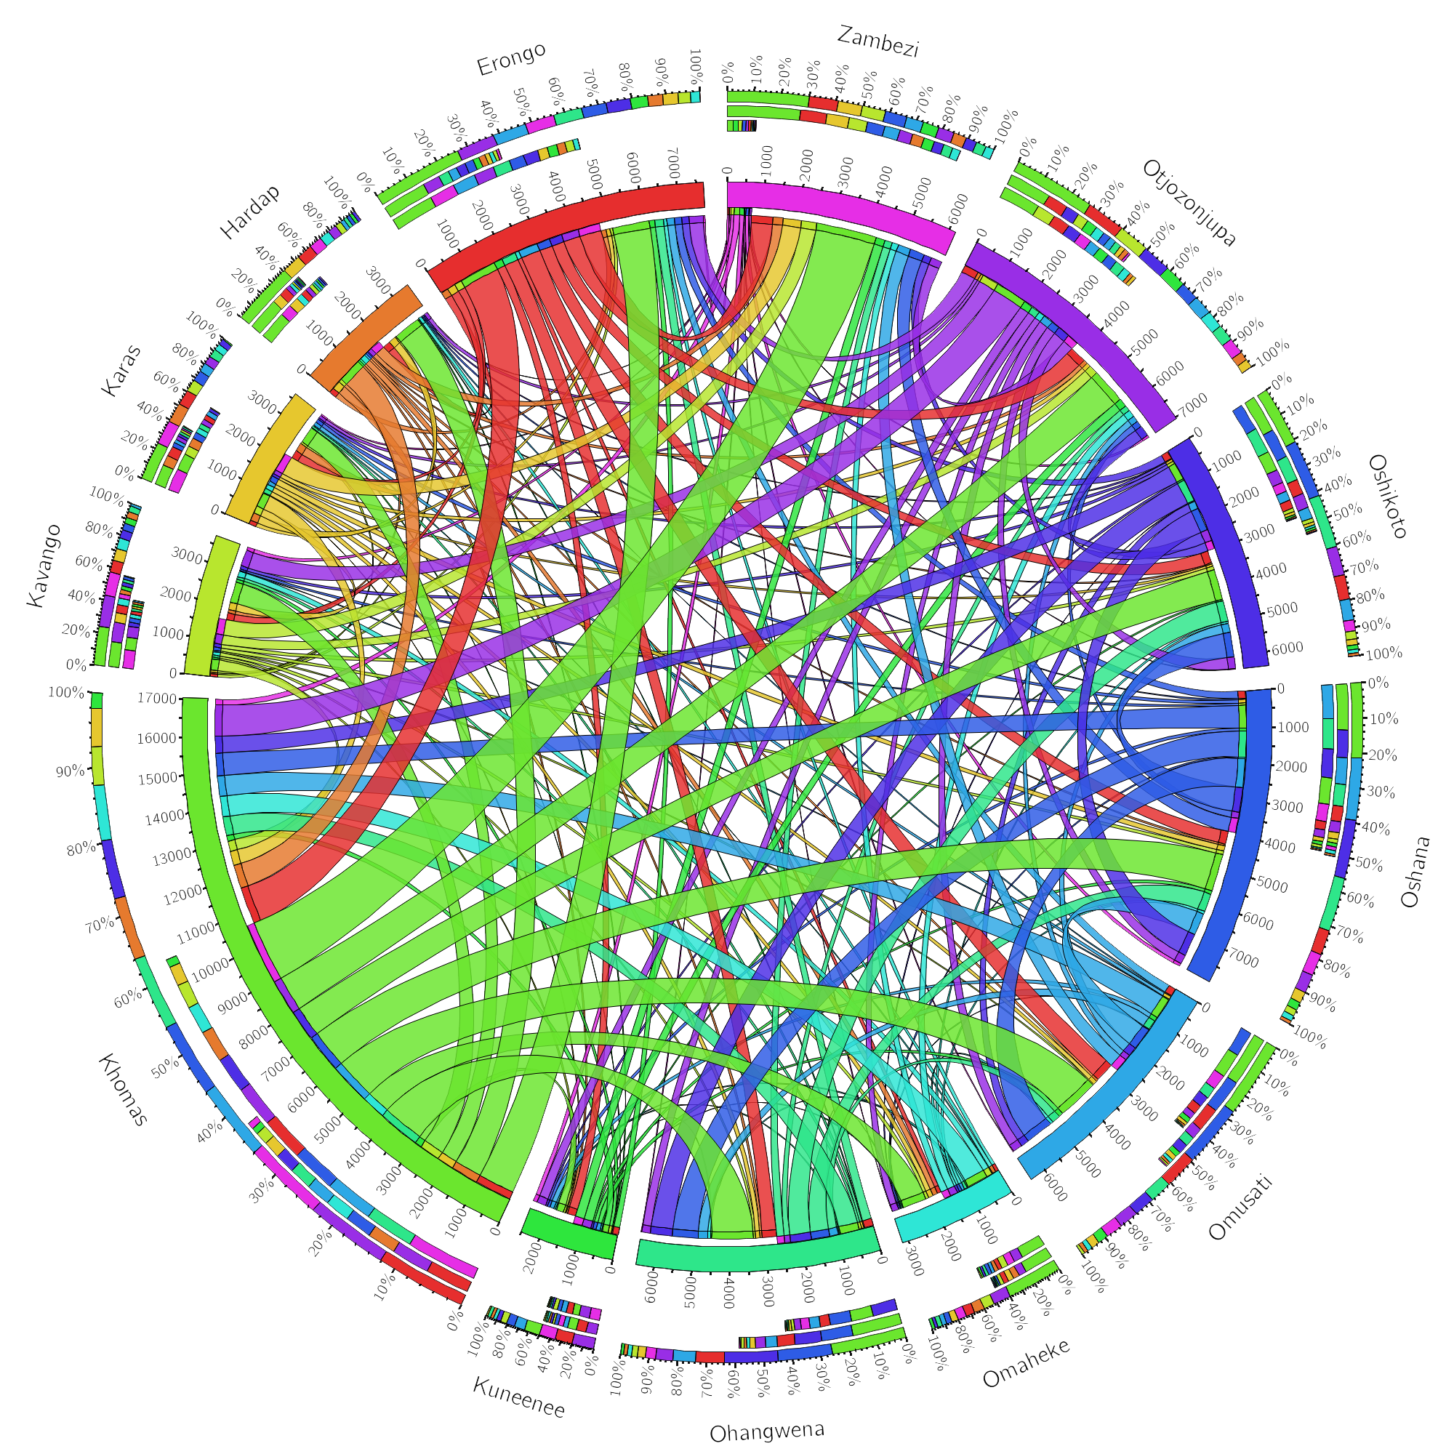
Short-term Migration from Region to Region in Namibia in 2011
Recreated Image
Figure 2.

Slide 16
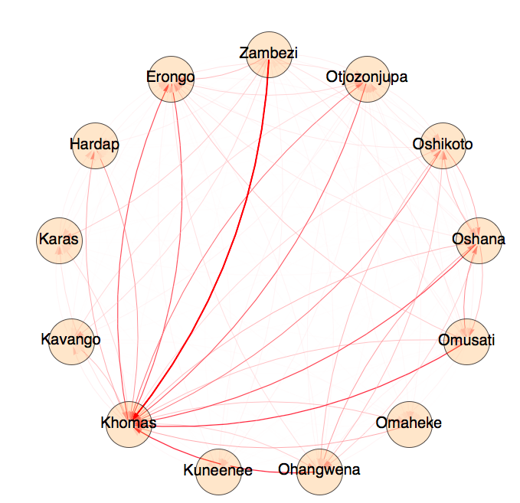
Figure 3.
Short-term Migration from Region to Region in Namibia in 2011

Slide 17
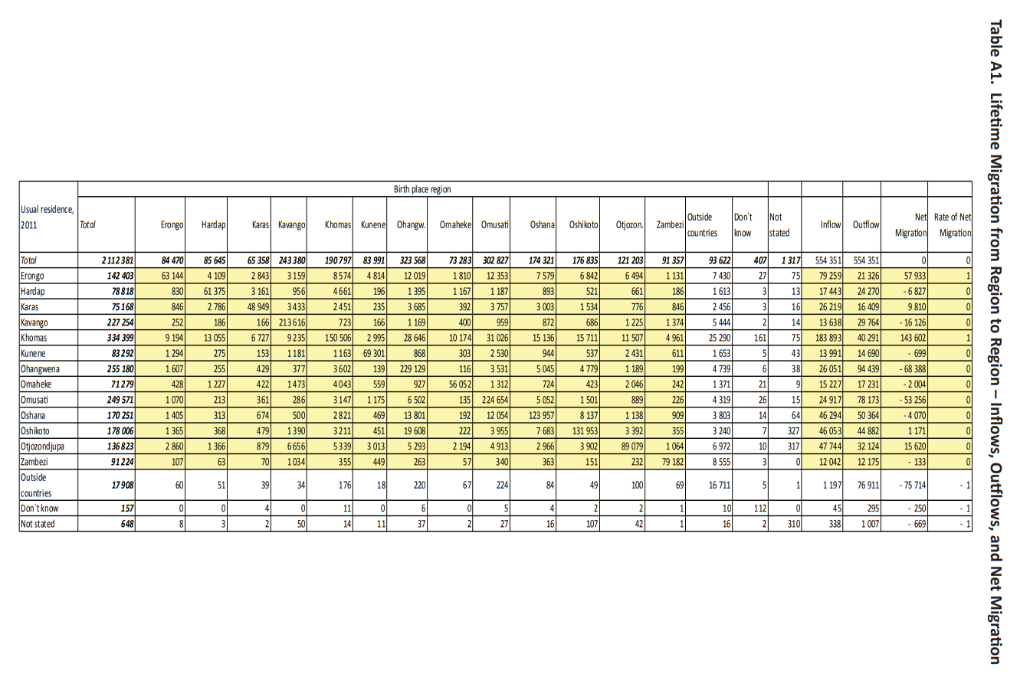

Slide 18
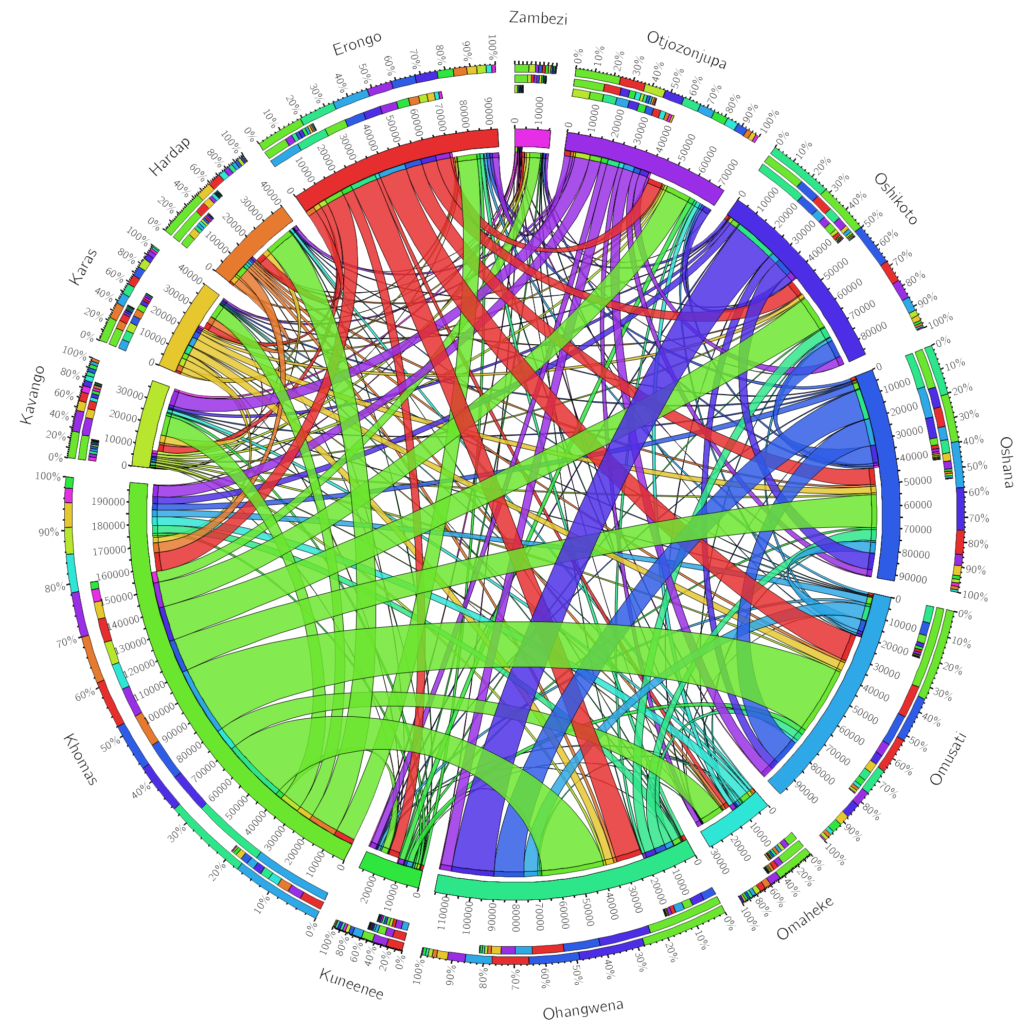
Recreated Image
Lifetime Migration from Region to Region in Namibia in 2011
Figure 4.

Slide 19
Details of the Dataset
What are some existing biases we have found?

Slide 20

Existing Biases...
Mobile User Only
Mobile users do not represent the entire population. the CDRs may only provide a partial picture of the migration, excluding those do not have a phone.
Urban Area Only
Mobile network coverage may be substantially lower in remote rural location.
Educated Males
Mobile phone owners typically consist of males that are more educated.
High share of ownership at household level
Hard to track precise migration population if multiple people share the same phone.

Slide 21
Credits
Shengjie et al. “Exploring the use of mobile phone data for national migration statistics” https://www.nature.com/articles/s41599-019-0242-9
“Namibia 2011 Population and Housing Census Report “. https://cms.my.na/assets/documents/p19dmn58guram30ttun89rdrp1.pdf
“Migration Report”. https://cms.my.na/assets/documents/Migration_Report.pdf

Slide 22
Thank you!
It has been a great semester :D

